Slide 1
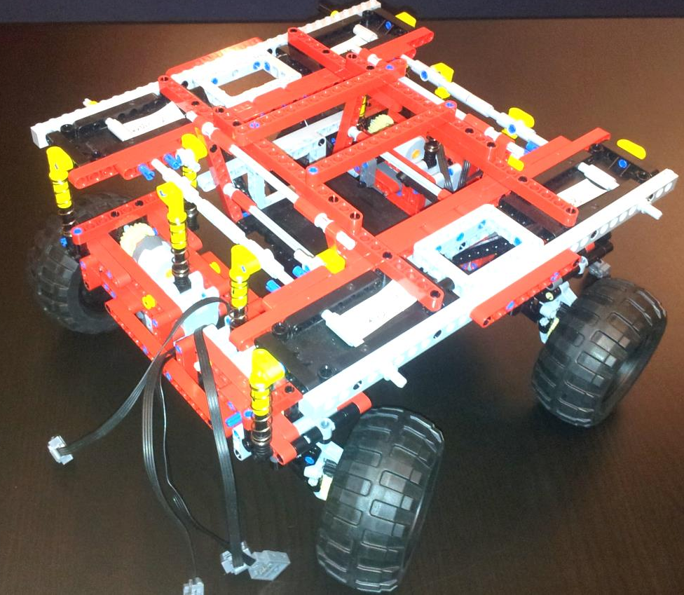
HW/SW Co-Design with a LEGO car
Group – LEGO 4 wheel 8 motors

Slide 2
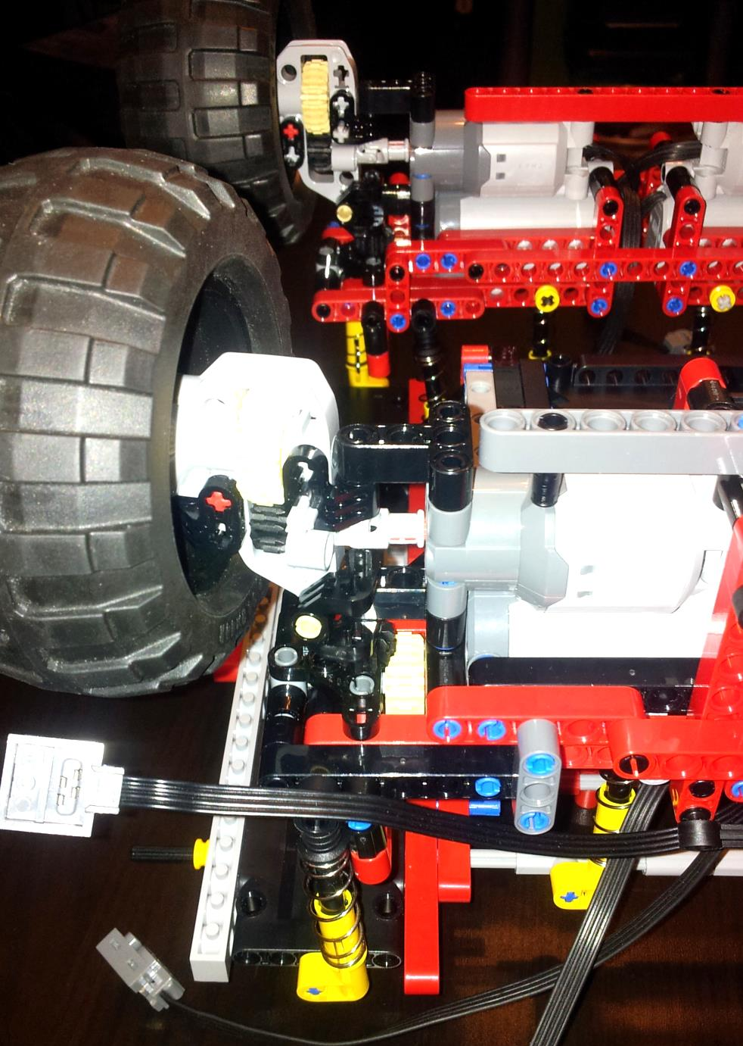
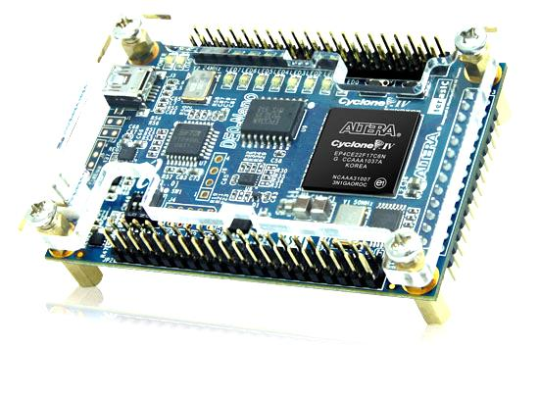
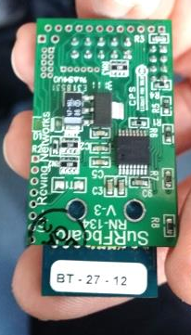
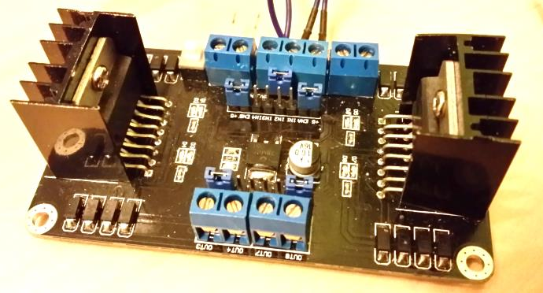
Initial position:
Prebuilt Lego-Car with 8 motors
-> 2 motors per wheel
DE0-Nano Board with FPGA
H-Bridge
WiFi Chip

Slide 3
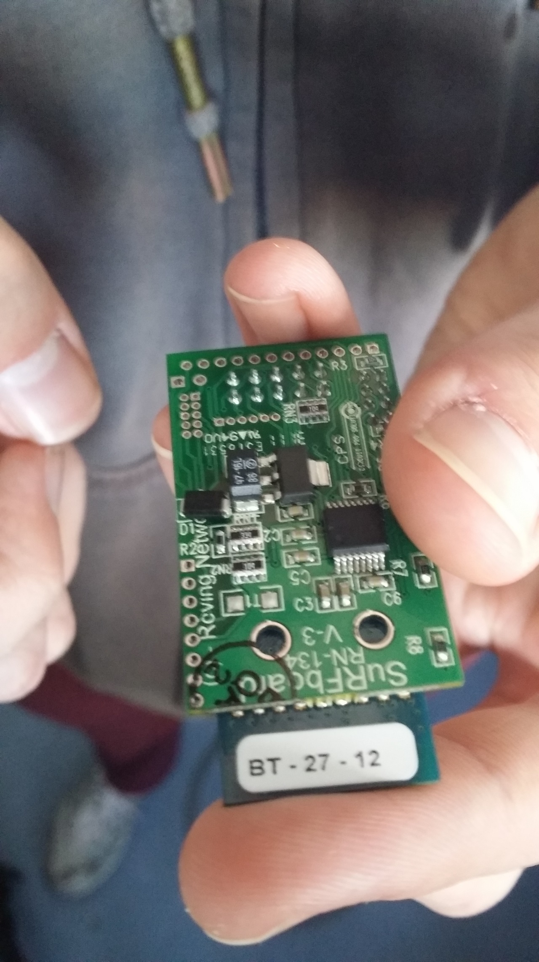
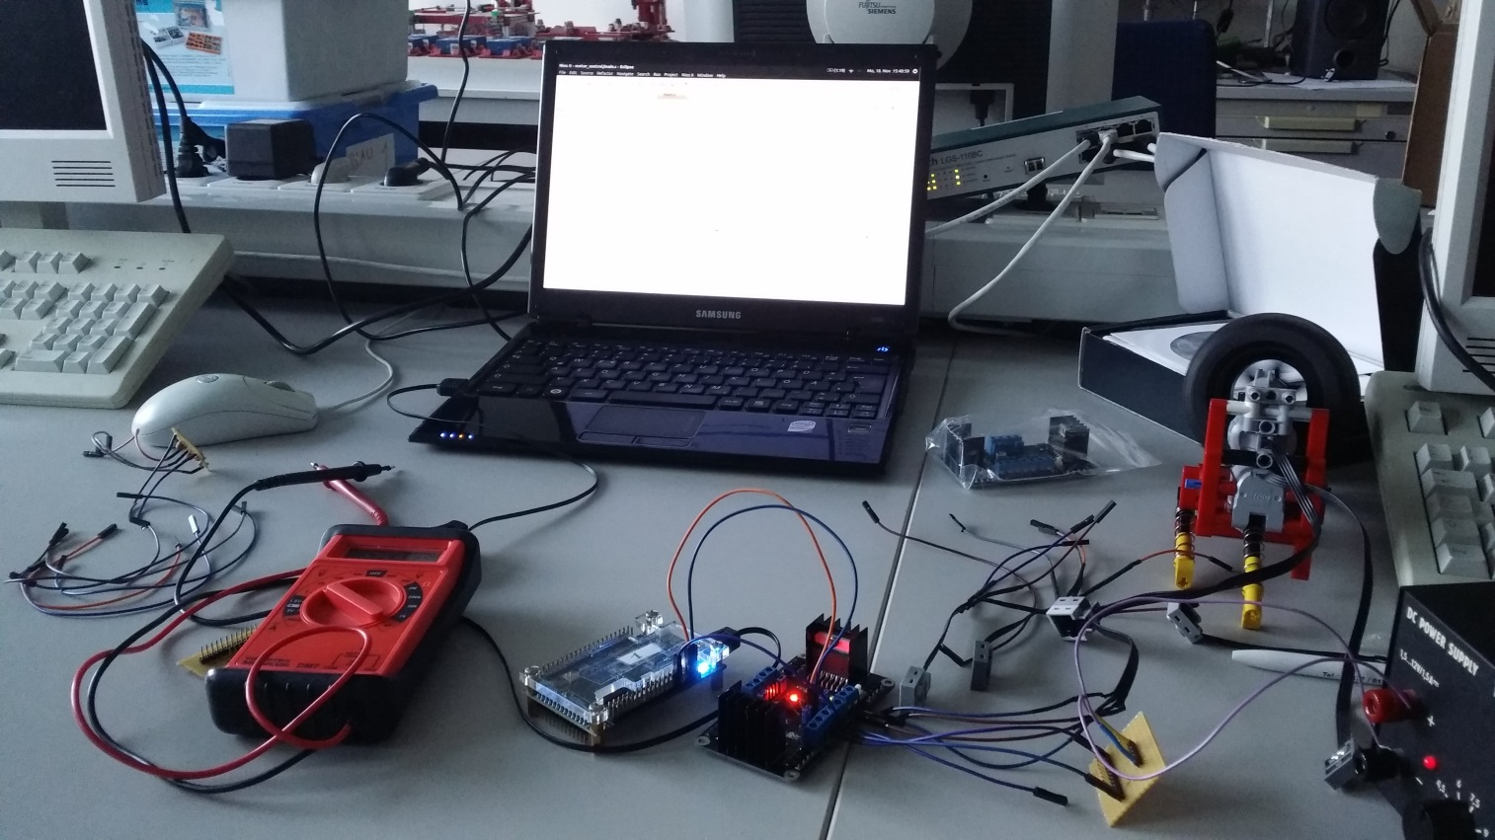
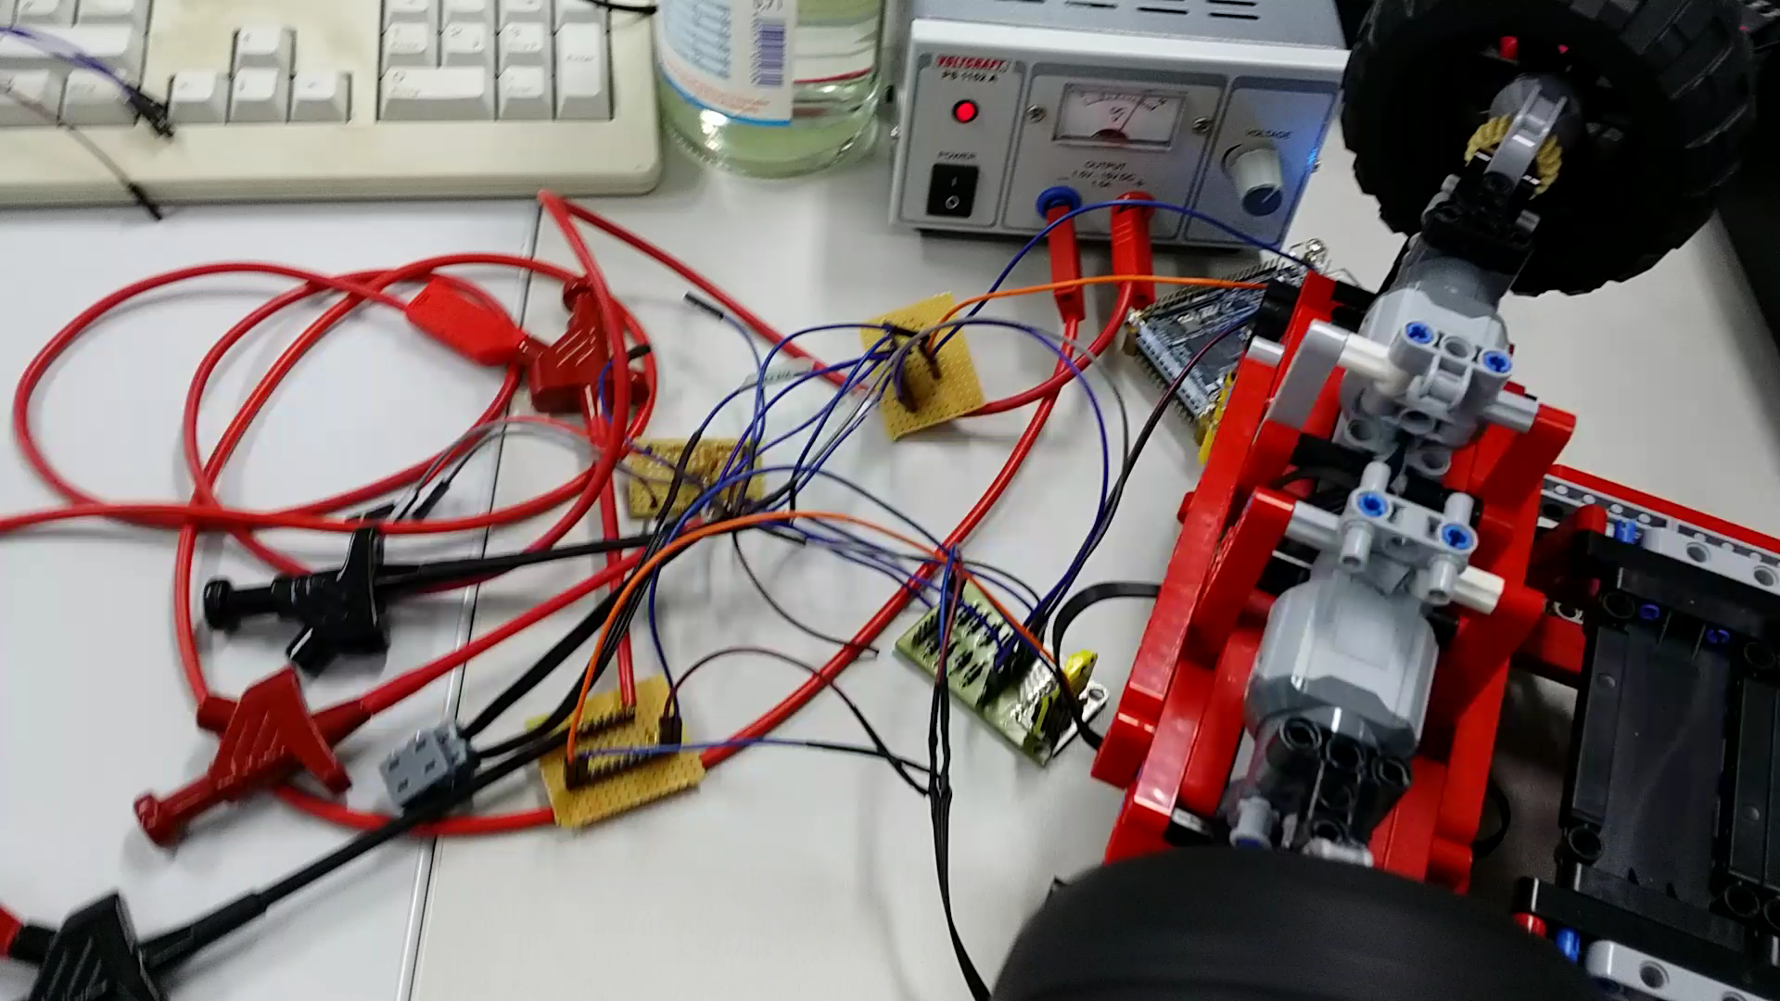
Problems:
Broken WiFi Chip
Lack of cables
Accomplishments:
Switched some gears for more sturdiness
Voltage control on one motor with FPGA

Slide 4
Alibi | Raphael, Adhir | Markus, Antonio
Setup Access Point | Straight movement Controlling the angles of the wheel | User interface
Process data received from network and send feedback | Reading data from acceleration sensor | Setup WIFI
Control engines remotely | Calculating speed and distance with acceleration sensor | Send control signals
 | Control Engine speed with A.S. | Receive feedback
 | Control angle of wheels by A.S

